Slide 1
Final stage of pre-processing
In His Name, the Most High
Inshallah!

Slide 2
Sentence generation via synonym replacement
01. Synonym augmentation
02. Word embeddings
NLTK (wordnet), Spacy, …
GloVe, Word2Vec, …
03. Contextual word embeddings
04. Mix
05. Other
BERT, …
Wordnet + GloVe + BERT + some supervision
Tfidf, random misspellings, other parameters, boring & time consuming!

Slide 3
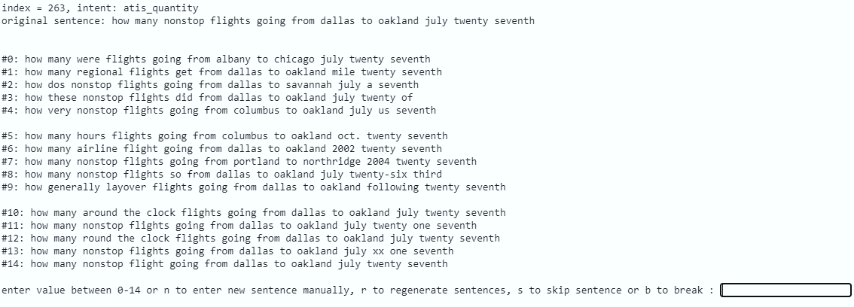
Example
Generated by BERT
Generated by GloVe
Generated by wordnet

Slide 4
Dropping similar sentences
01. Word embeddings
04. Similarity score & threshold
BoW, Word2Vec, GloVe, FastText, Transformer,...
Jaccard, WMD, Euclidean, Cosine, …
threshold → similar pairs
02. Sentence embeddings
05. End Notes
Doc2Vec, Sent2Vec, SentenceTransformer
🗸 Transformer based → SentenceTransformer → stsb-mpnet-base-v2 → Cosine similarity
03. Pretrained models
stsb-mpnet-base-v2, stsb-roberta-base-v2, stsb-bert-large, …

Slide 5
Clustering
01. K-means
02. Agglomerative Clustering
Clusters count?
Hierarchical Clustering / Dendrogram?
Affinity → Cosine, Euclidean, Manhattan, …
linkage → Average, Ward, …
Distance threshold

Slide 6
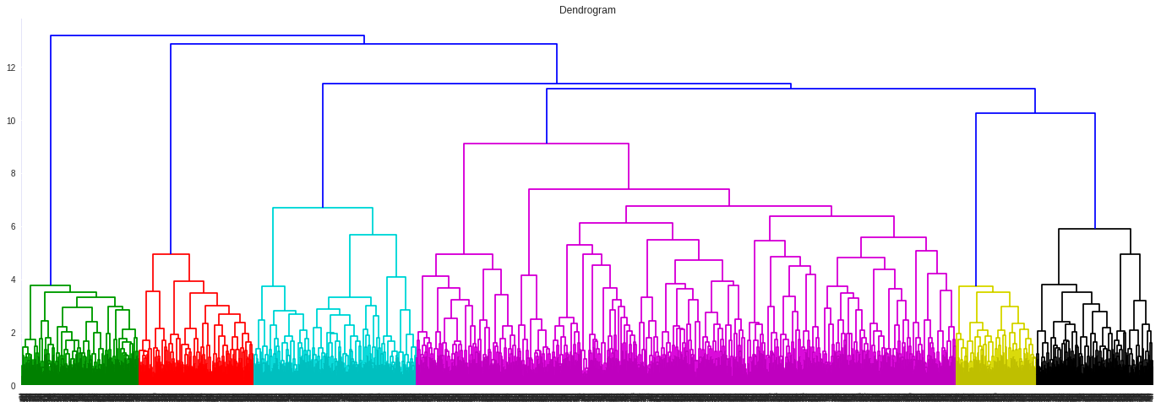
Dendrogram

Slide 7
Thank You! Final result → Jupyter notebook

